Slide 1

An Introductory PowerPoint:
Fahrenheit 451 by Ray Bradbury
The temperature at which book paper catches fire and burns

Slide 2

Fahrenheit 451
1947 – began as “Bright Phoenix” which contained seed for…
1951 – “The Firemen,” a short story published in Galaxy magazine and expanded…
1953 – Fahrenheit 451, a novel written at a time when the world was threatened by nuclear war, new technologies were emerging, and the world was getting smaller due to technology.

Slide 3

Concepts Related to Fahrenheit 451:
Social criticism: mode of criticism that addresses malicious conditions in a society considered to be flawed and aims at practical solutions.
Fahrenheit 451 warns against the dangers of suppressing thoughts and ideas through censorship
Science fiction: a form of fantasy in which scientific facts, assumptions, or hypotheses form the basis of adventures in the future, on other planets, in other dimensions in time, or under new variants of scientific law
Fahrenheit 451 conveys a message that oppressive government, left unchecked, can do irreparable damage to society by limiting the creativity and freedom of its people.

Slide 4

Additional Concepts
Totalitarian society – a society centrally controlled by an autocratic leader with strict control of all aspects of life and subordination of the individual to the state
Dystopian society – an imagined place or state in which everything is unpleasant or bad
*Propaganda is used to control citizens.
*Information, independent thought, & freedom are restricted.
*A figurehead or concept is worshipped by citizens.
*Citizens feel trapped & struggle to escape.
*The natural world is banished & distrusted.
*Citizens are dehumanized.
*The society is an illusion of a perfect utopian world.

Slide 5
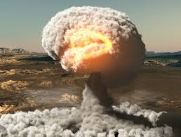
Historical Context
What Was Happening in the World in the 1950s?
World War II had ended only a few years earlier.
Nuclear warfare loomed.
More jobs led to Americans having more discretionary income which led to increased passivity and conformity and the adage of: “Follow orders, and you will succeed.”
Era of McCarthyism brought new vigor to Truman’s hunt for Communist infiltrators.
Technology/electronics expansion included the use of televised surveillance footage for many purposes and the condensation of information into sound bites.
Illiteracy was growing.

Slide 6

PREVENT
PREDICT
Bradbury
claimed he
was trying
to prevent
the future,
not
predict it.
However, he did anticipate the future:
Seashell radios
Parlor walls
Interactive TV
Population explosion
Rise in violence
Growing illiteracy
Condensation of information
Dehumanization & impersonalization of life
Elimination of books
Loss of meaningful interaction with others
Surveillance by police and government
Reliance on technology to mediate all social experiences

Slide 7
TWO CENTRAL THEMES
CENSORSHIP
IGNORANCE VS KNOWLEDGE
The suppression of speech or deletion of communicative material which may be considered objectionable, harmful, sensitive, or inconvenient by a controlling group.
Without the ability to think, people can not make wise decisions.
In Fahrenheit 451 firemen promote ignorance by destroying books – and with them – knowledge.

Slide 8

ADDITIONAL THEMES
Individual self-expression is important.
Censorship deprives self-expression.
Violence is self-destructive.
Mindless pleasure-seeking & materialism makes
for an empty life.
Humanity has the ability to be reborn or revived.
In the wrong hands, modern technology can be dangerous.
Commercialism can erode or overpower spiritual values.
People lose their humanity if they are not able to communicate and interact with each other on a personal level.
Humanity should preserve and value the culture of the past.

Slide 9

IN THE NOVEL:
Books are considered dangerous and therefore are illegal.
No one can own books.
Most people strive for happiness which they find through being plugged into their technology, where they do not have to think too hard.
Firemen do not stop fires; they start them. They are the happiness squad. They destroy books when found and often the homes of those who have the contraband.

Slide 10
SETTING IN THE NOVEL
TIME: Future – Bradbury identifies the time period as 1999; Granger, a character from Part III mentions the atomic bomb’s destruction 50 years ago; other scholars identify time as 24th century
PLACE: America; Montag’s cold & violent city; the firehouse, Montag’s home (mausoleum-like), Faber’s home, simple forest
ATMOSPHERE: A repressive government censors all literature, citizens lives are filled with trivial distractions, people desire happiness in any way they can obtain it, technology rules, war is imminent, and people do not think for themselves.

Slide 11

INTERNAL CONFLICTS IN THE NOVEL
Man vs himself
1. Montag and his struggle to overcome his violent past and going against the tenets of his profession
2. Faber overcoming his fears and helping Montag

Slide 12


EXTERNAL CONFLICTS IN THE NOVEL
Man vs society
Montag vs society
Clarisse McClellan vs society
Professor Faber vs society
Man vs man
Montag vs Beatty
Montag vs Midlred

Slide 13

SYMBOLS IN THE NOVEL
Phoenix
The Hearth and the Salamander
The Sieve and the Sand
Mechanical hound
Old woman
Mirrors
Birds
Captain Beatty
Mildred
Montag
Books

Slide 14
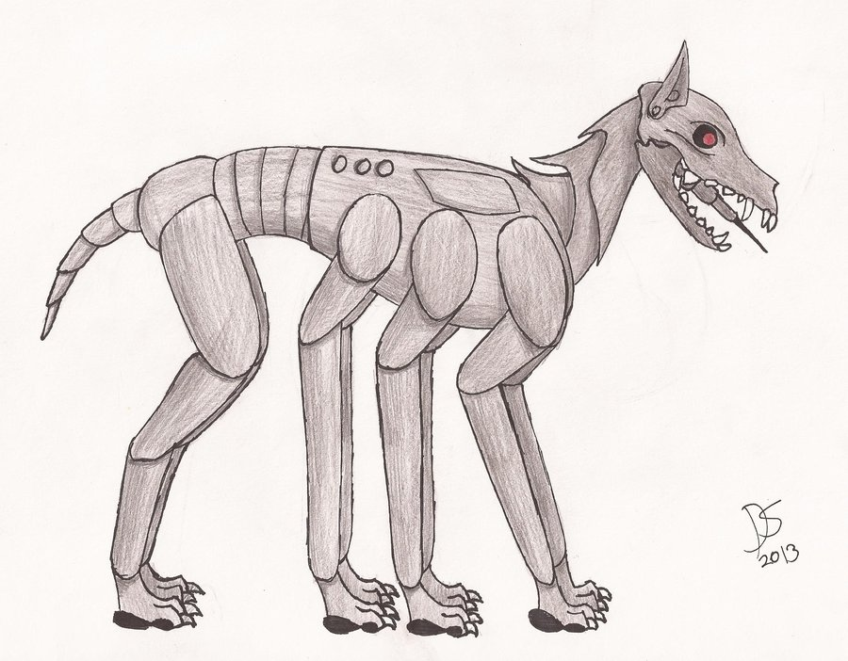
CHARACTERS IN THE NOVEL
Guy Montag
Mildred Montag
Captain Beatty
Professor Faber
Clarisse McClellan
Granger
Mrs. Phelps
Mrs. Bowles
Old Woman
Mechanical Hound
Stoneman and Black
Book People

Slide 15
POINT OF VIEW
Third Person
Limited Omniscient -
Montag’s thoughts and feelings

Slide 16
Predictions:
Based on the notes you just completed, along with the various pre-reading activities we completed last week…
Write a one paragraph (6-7 sentences) predicting the following:
What is this novel going to be about?
What will be the outcome at the end of the novel?
There are no right or wrong answers, but we will be discussing these predictions throughout our reading, so be prepared to share.

